Slide 1


Slide 2

INTRODUCTION
Key to university’s prosperity is its management of its classes and faculty members. Therefore, an idea to encounter with hurdles is a program that creates a link between faculty and students. It provide a very handy and easy-to-use graphical interface to the user.

Slide 3
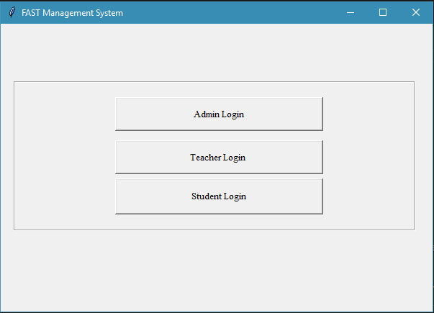
LOGIN :
THIS APPLICATION IS DEVELOPED FOR 3 USERS: ADMIN, TEACHERS AND STUDENTS.

Slide 4
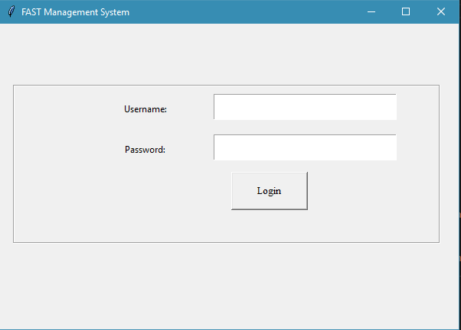
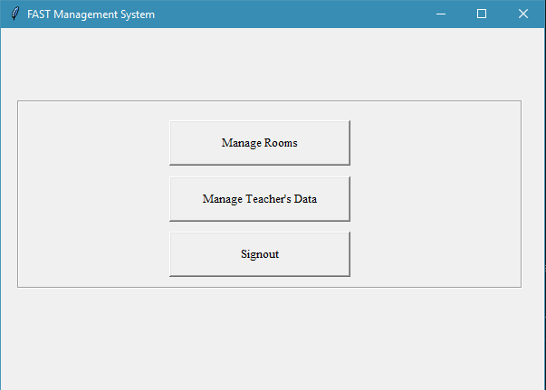
ADMIN FEATURES:
ADMIN CONTROLS TEACHERS BY ADDING/UPDATING AND DELETEING THEM. ADMIN CAN ALSO BOOK ROOMS ON THE CAMPUS.
HERE ADMIN NEEDS TO ENTER HIS ID & PASSWORD

Slide 5
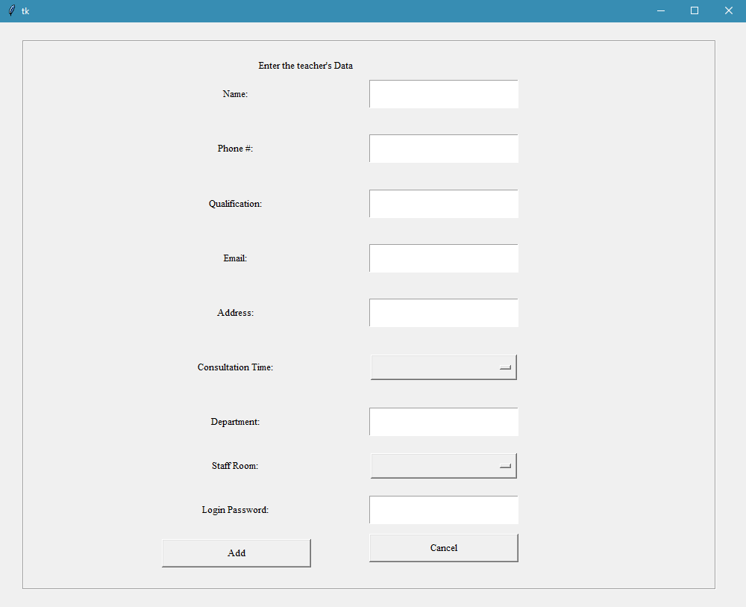
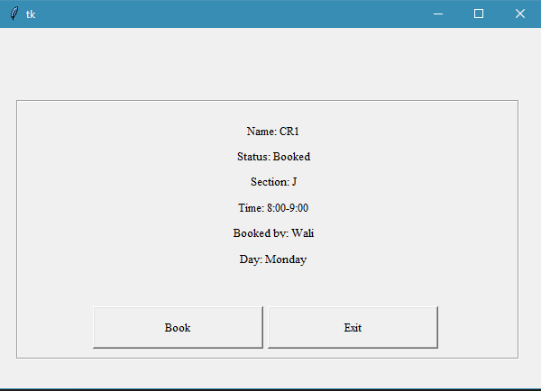
ADMIN’S FEATURES:

Slide 6
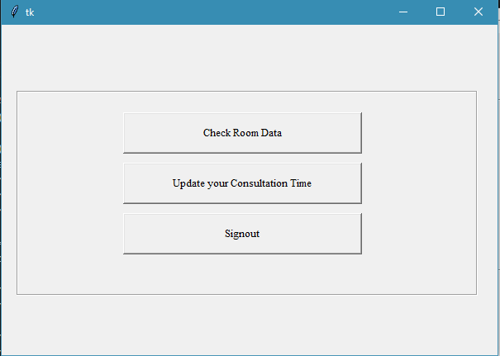
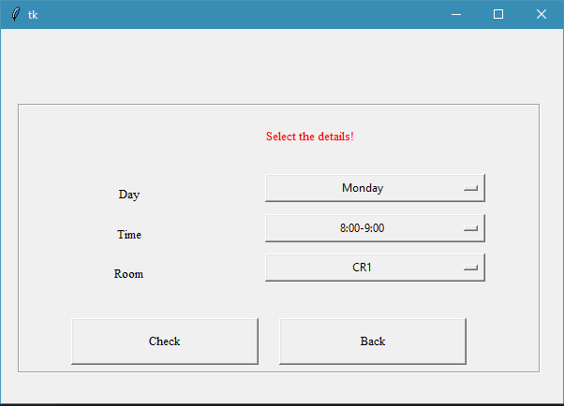
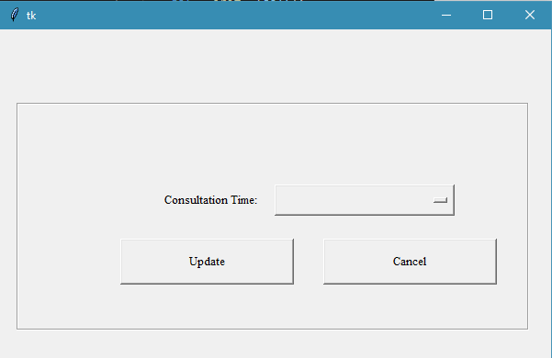
TEACHER’S FEATURES:
TEACHERS LOGIN WITH THEIR USERNAME AND PASSWORD PROVIDED BY THE ADMIN. TEACHERS CAN CHECK AVAILABILITY OF THE ROOMS AND UPDATE THEIR CONSULTATION TIME.

Slide 7
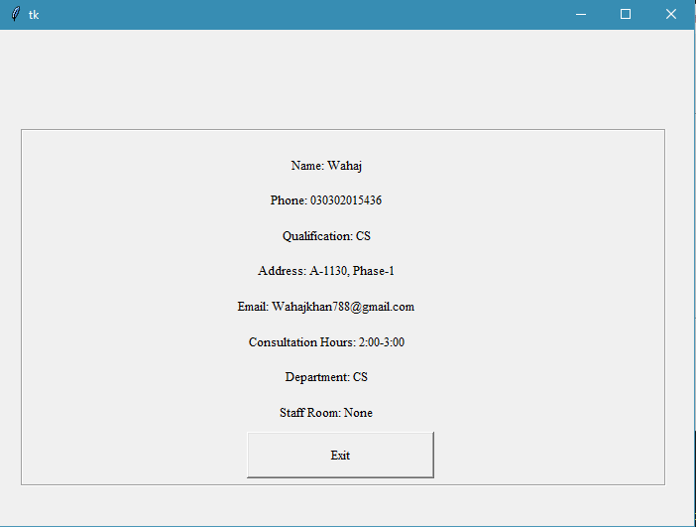
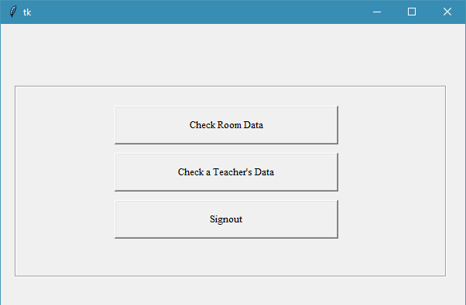
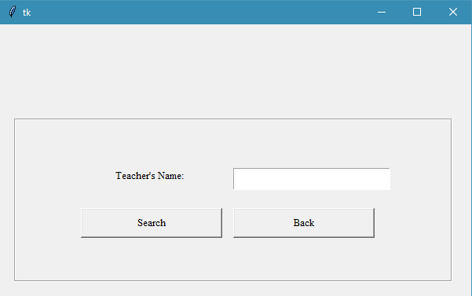
STUDENT”S FEATURES:
STUDENTS CAN ONLY SEE TEACHER’S DETAILS AND AVAILABILITY OF THE ROOMS ON THE CAMPUS

Slide 8
THANK YOU.

